Slide 1
Zero-day vulnerabilities
In Perl’s library ParseXLSX

Slide 2
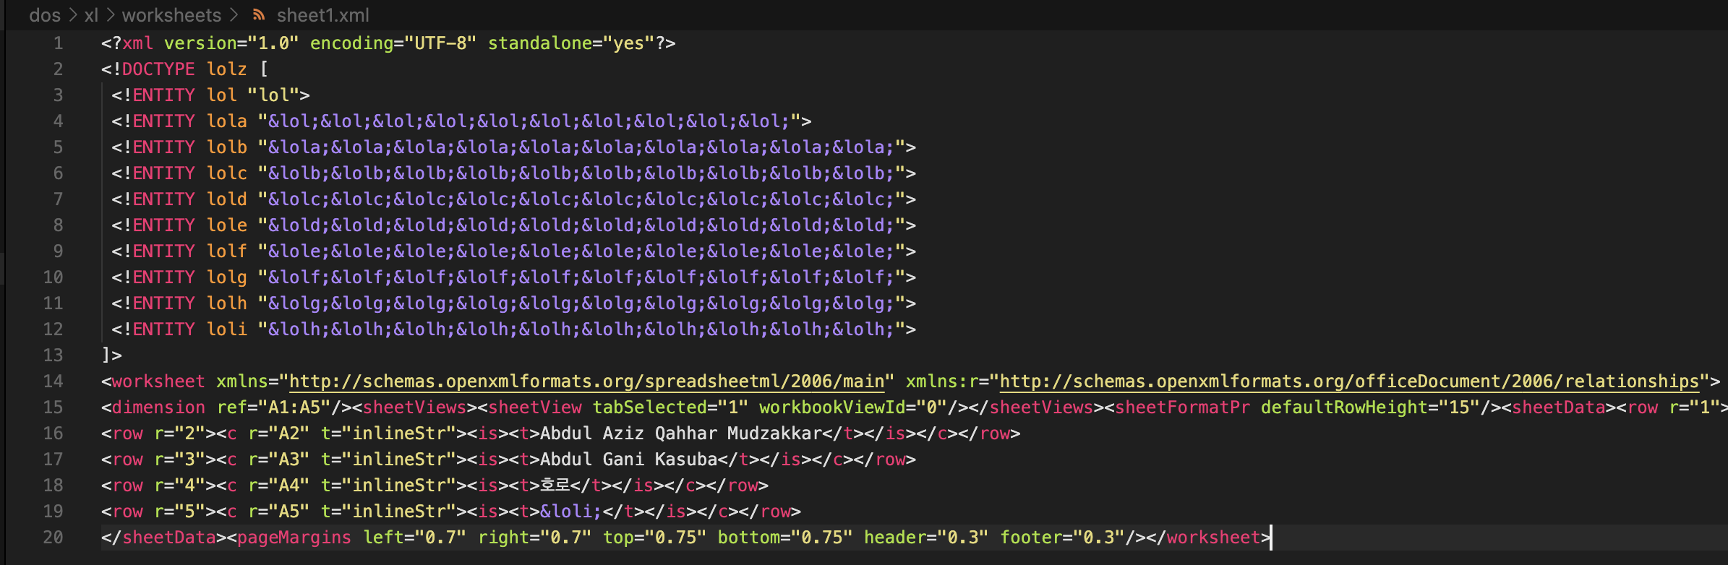
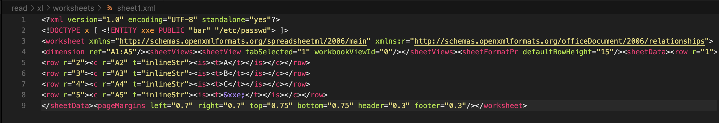
Prologue
One day, Mr. tried with the library ParseXLSX and found out it’s vulnerable to XXE attacks and reported in https://internal.com/sth/STHSTH-12345
Billion laughs attack
…and arbitrary read

Slide 3
Prologue
I was instructed to dig deeper and see if there is more vulnerabilities in this library
TL;DR: There is

Slide 4
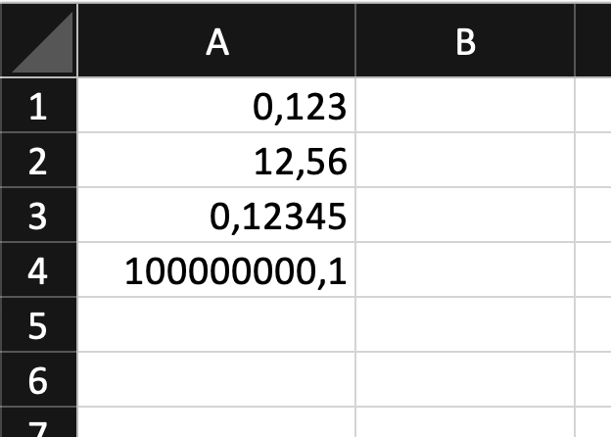
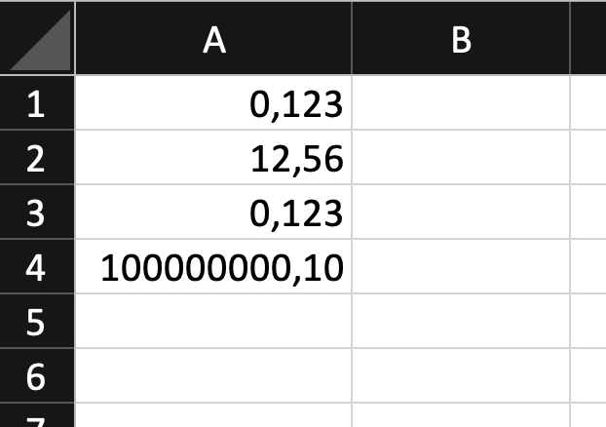
Vulnerable feature
Excel supports a feature to specify how a number, date value is displayed using a format string
No format string (raw data)
With format string #0,00#

Slide 5
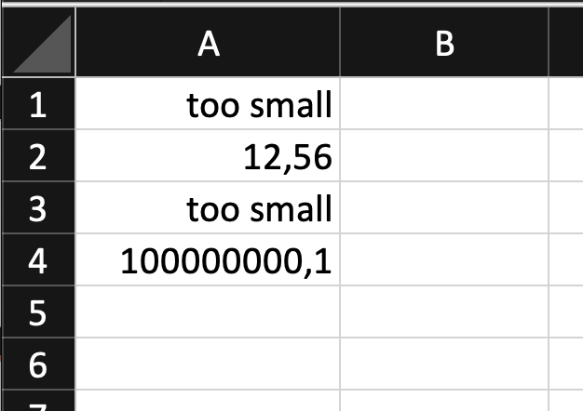
Vulnerable feature
Even better, it allows adding (nested) conditions as well
With format string [<1]"too small";[>1]General

Slide 6
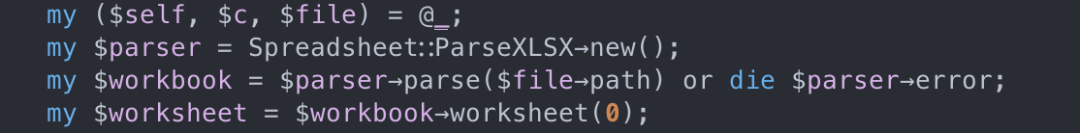
Entrypoint
Perl 5.30
ParseExcel::ParseXLSX 0.27

Slide 7
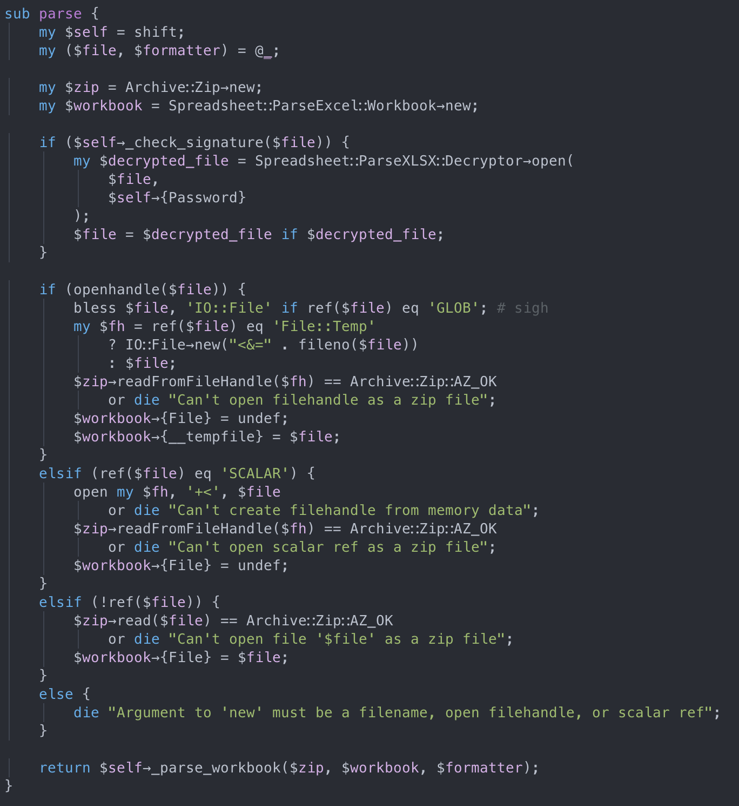
Analyze parse flow
Check file signature, try decrypting if encrypted
Supports many input type:
- file name
- file handle
- file content
Calls _parse_workbook
Notes:
For the sake of simplicity, I only insert the file name only, and tamper with the file data.

Slide 8
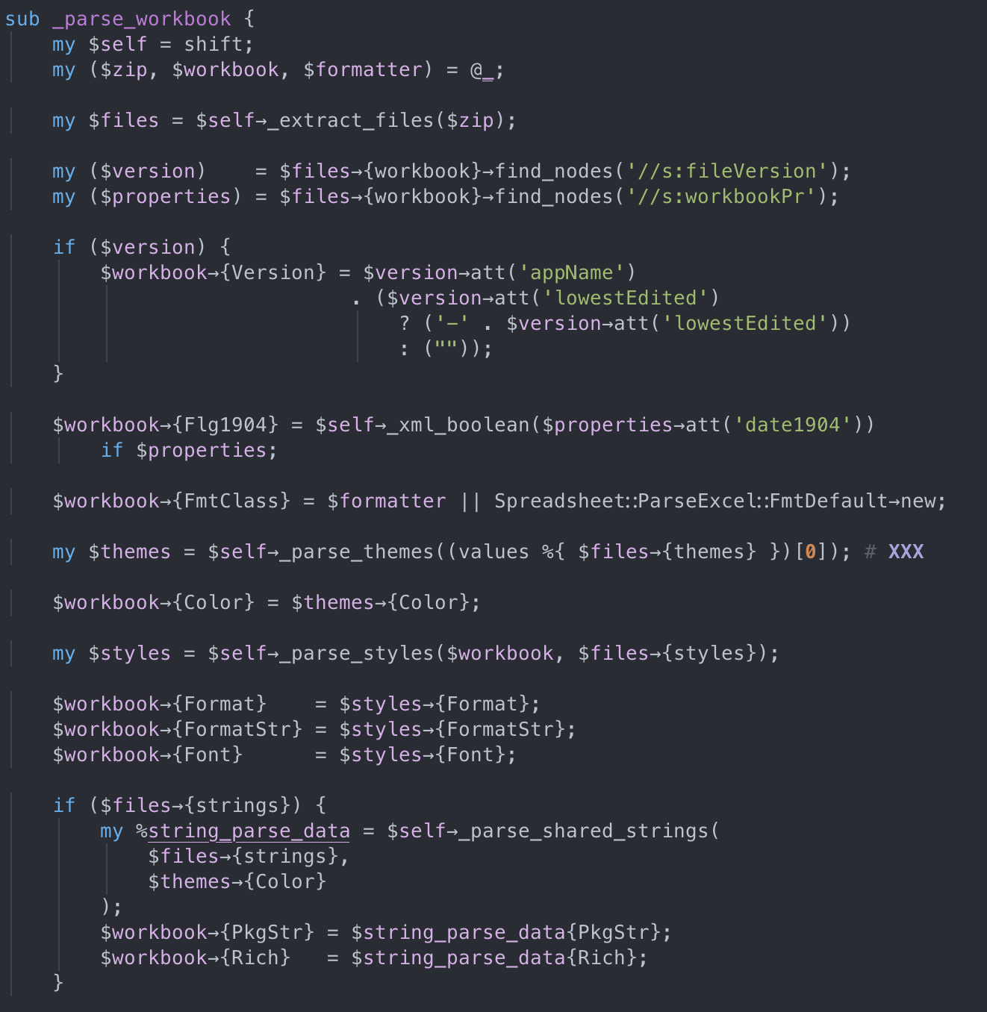
Analyze _parse_workbook flow
Unzip xlsx file, read xml configs and prepare a formatter class
Prepare some global configs of workbook (cell format, numeric string format, styles, etc)
Notes:
Note that formatter class is customizable, which means we can use our own formatter instead of theirs

Slide 9
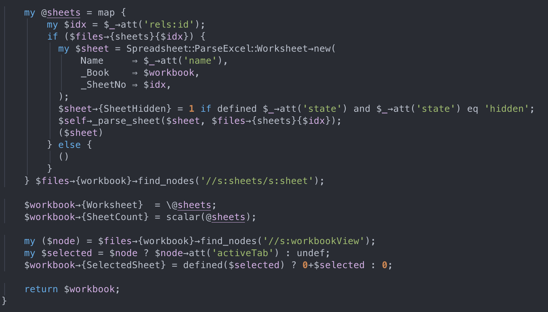
Analyze _parse_workbook flow
For each sheet node found, call _parse_sheet

Slide 10
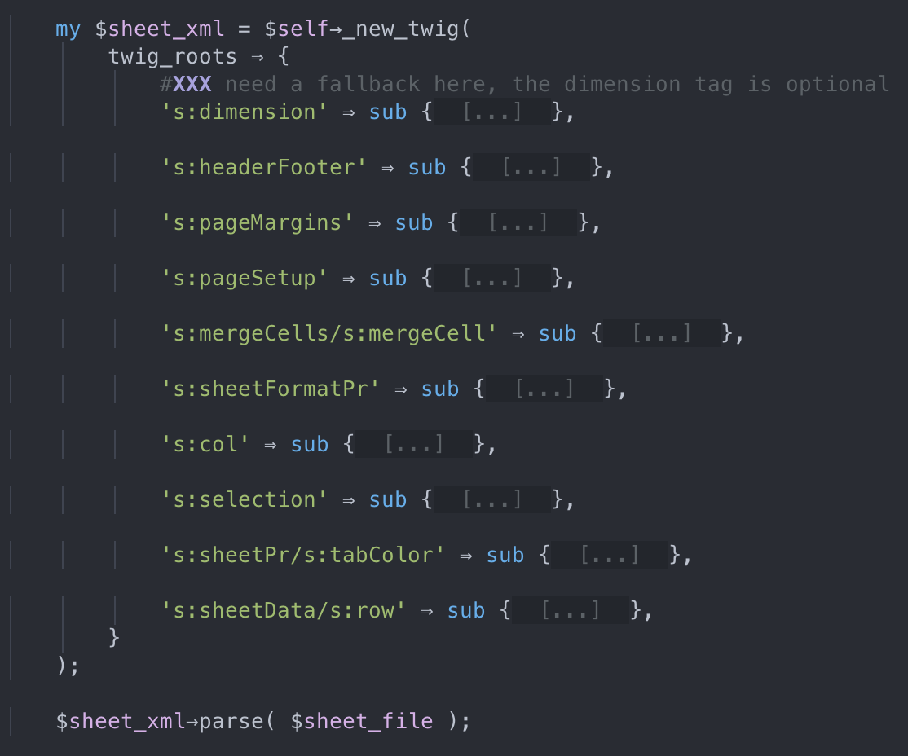
Analyze _parse_sheet flow
Sheet size (min/max width/height)
Header/footer name
Sheet margins
Save some configs for printing sheet?
Handles merged cells
Settings for rows & columns
Settings for each column (hidden, styles, etc)
Current cell selection
Self explanatory
Data for each cell in each row
Notes:
There are many parts, but only 2 are quite interesting.
I'll go through the data handling for each cell first, because it's the place causes most impact.

Slide 11
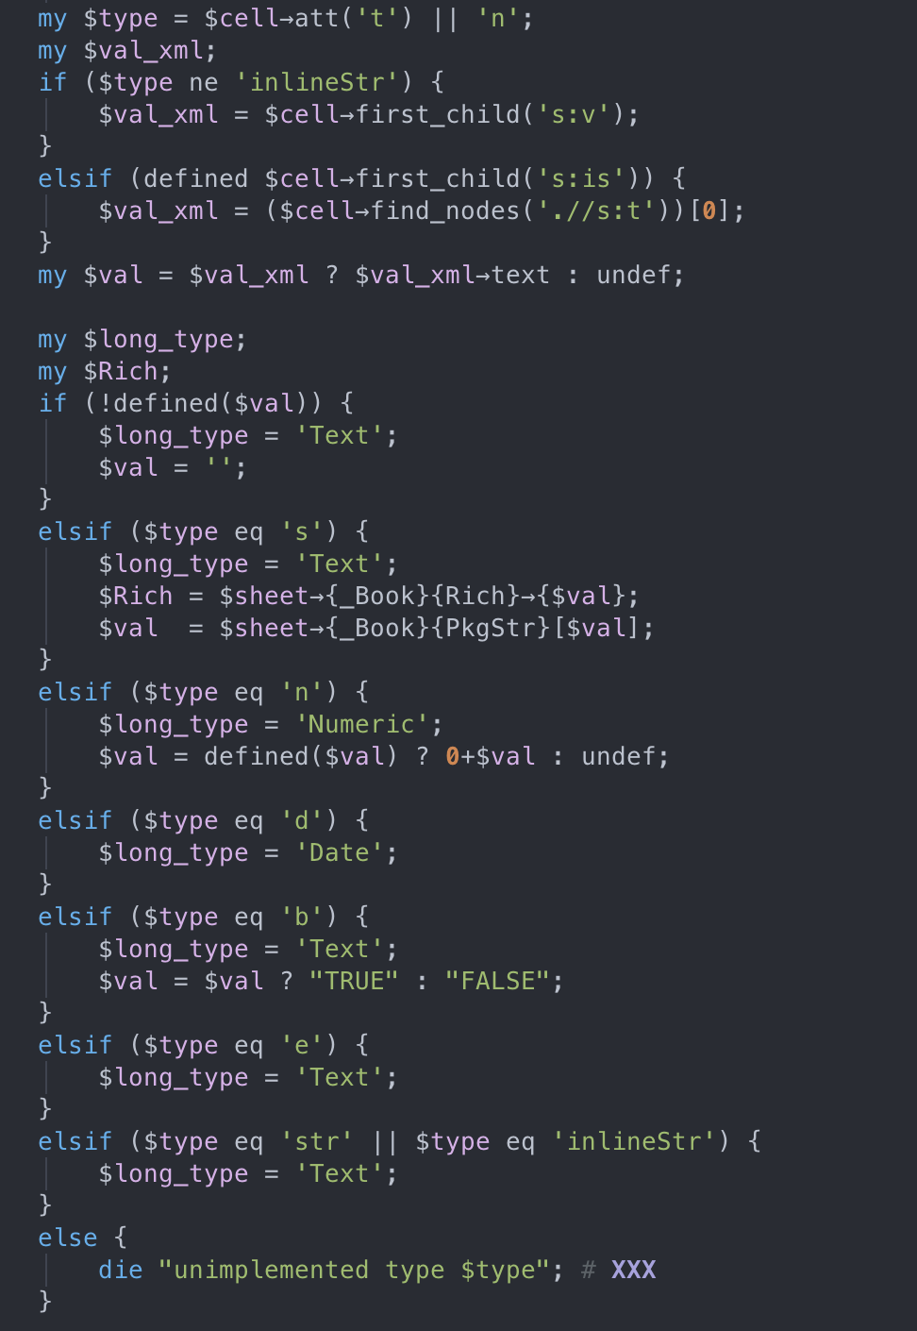
How it reads cell data
$cell : current cell object
This block performs type checking and applies type casting accordingly.
Also maps type characters into a string $long_type

Slide 12
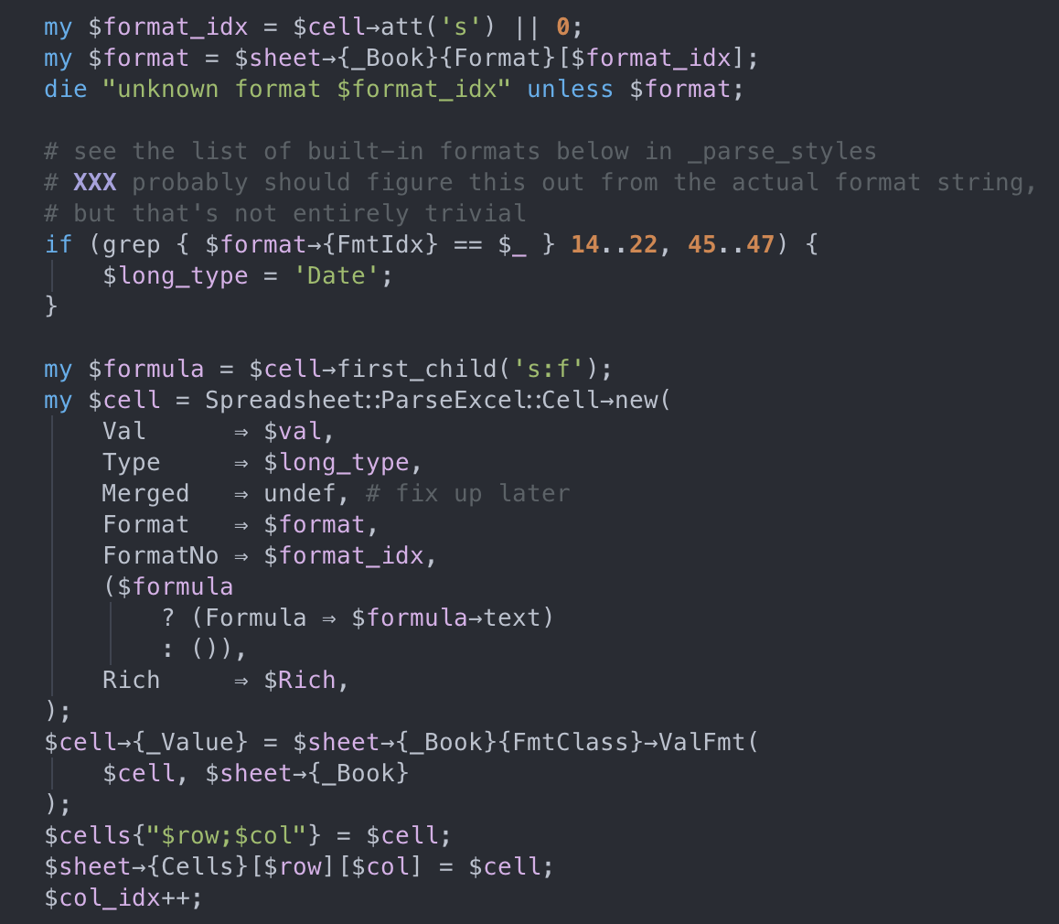
How it reads cell data
Maps format id attribute to its corresponding format string (default or custom)
Initialize another cell object, calls ValFmt
Notes:
I'll skip this first part, since it doesn't affect our attack vector

Slide 13
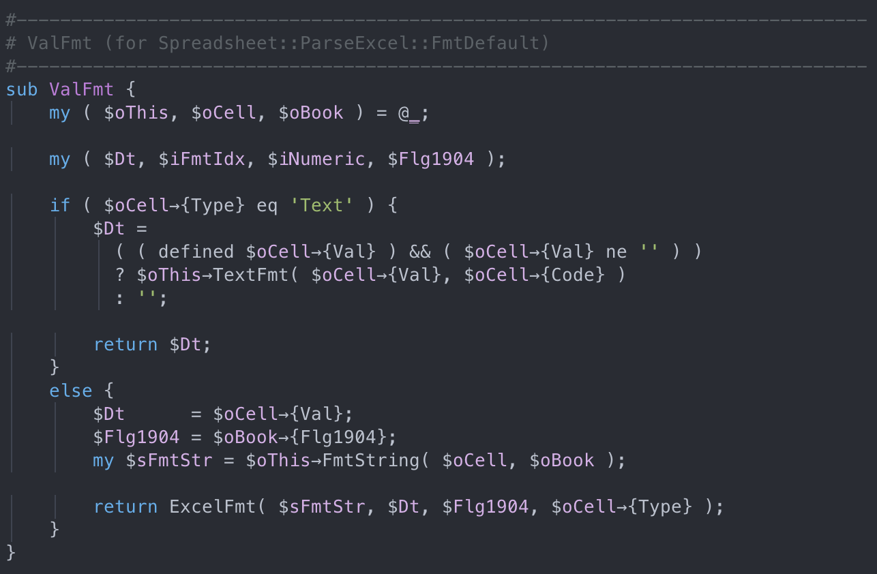
How it formats cell data - ValFmt
If type is text, perform null checks and encode in utf-8
Ignore
Else, grab its format string and call ExcelFmt
Where the fun begins
Notes:
Because of this, we wouldn't want our data type to be Text

Slide 14
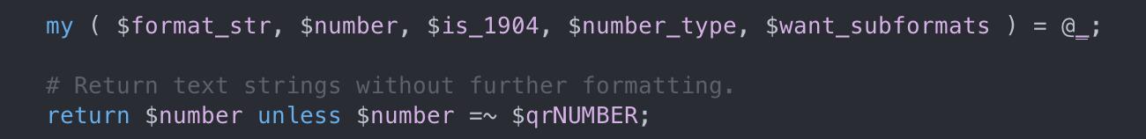
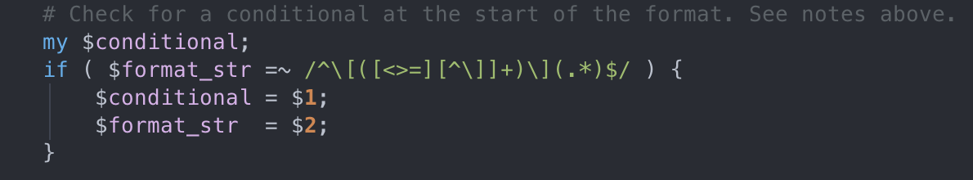
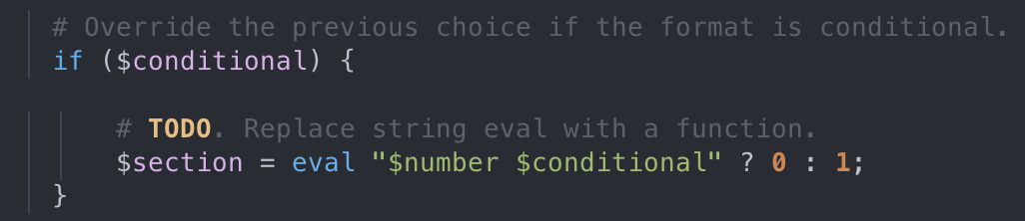
How it formats cell data – ExcelFmt
If the cell value ($number) doesn’t follow (scientific) number format, early stopped
If the format string follows conditional format string “format”, takes the condition…
... and put in eval ¯\_(ツ)_/¯
Notes:
We just need to make sure the value of the cell is a valid number
So, what we wanted is to inject a shell command into the condition part of this format string.

Slide 15
Attack vector
Extract format strings
+
Extract cell formats
Payload is injected
in .xml file
Unzip .xlsx file
Eval payload in the condition part
Get correct format string for ValFmt
Setup malicious cell to be Date type

Slide 16
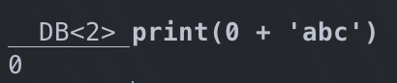
Why Date type?
There are only 2 types apart from Text: Date and Numeric
But $val is casted into a number for Numeric type
…so the only option left is Date

Slide 17
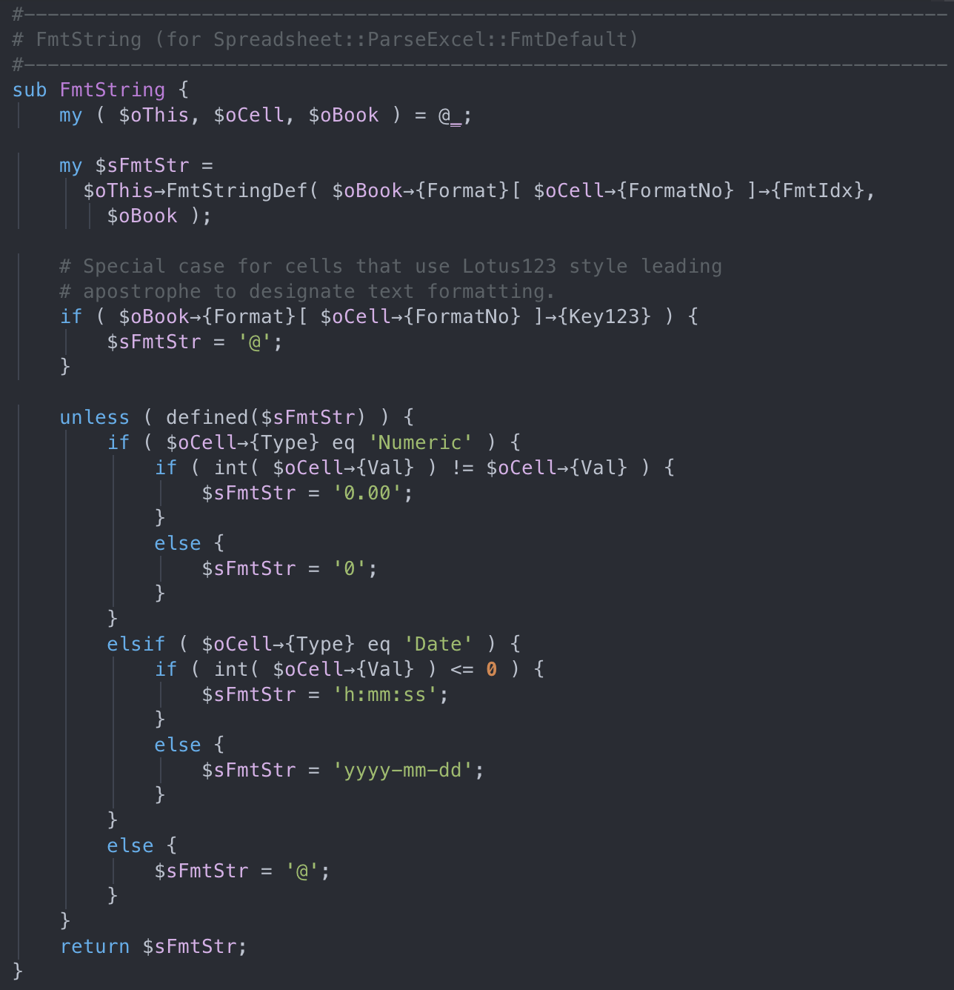
Where’s Perry format string?
Notes:
Get back to ValFmt subroutine, it calls FmtString to get the correct format string, so let's take a look

Slide 18
Where’s Perry format string?
Interesting!
Default format strings
=> useless for the exploit
Notes:
Apart from the first few lines, the rest are just handling the case where format string cannot befound, a default format string will be returned instead.
We'll dig deeper what the first lines do

Slide 19
Where’s Perry format string?
So FmtStringDef takes a 2 parameters: $iFmtIdx and $oBook
What’s that?
$oBook→{Format}[ $oCell→{FormatNo} ]→{FmtIdx}
List of cell formats in the workbook
Id of the cell format applied for this cell
Id of the corresponding format string
Notes:
The value passed to FmtStringDef is simply a mapping
It basically takes FormatNo from the current cell, use it as the index in Format array of current workbook, and finally take FmtIdx property.

Slide 20
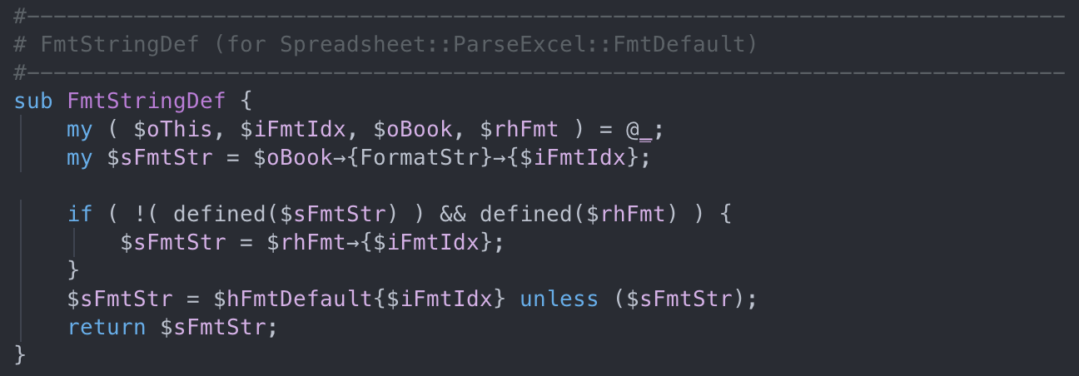
Where’s Perry format string?
Get the format string for this cell corresponding to the $iFmtIdx
Ignored, since the caller didn’t pass rhFmt
Fallback if corresponding format string is not found
Notes:
Inside FmtStringDef subroutine, it uses iFmtIdx as the key to get the actual format string in the dictionary FormatStr of current workbook.

Slide 21
Recap
$oBook
$oCell
FmtString($oCell)
FormatStr{}
Format[]
0: format_string_1
{
FmtIdx: 0,
…
}
{
FormatNo: 1,
…
}
1: format_string_2
123: [>123; command]
{
FmtIdx: 123,
…
}
{
FormatNo: 0,
…
}
…
Notes:
Simply put, all we need to do is perform a proper mapping to pass our command.
First, the malicious cell contains the FormatNo
Which is the index of malicious format in workbook's Format array
This format item contains a number FmtIdx
That is the key pointing to our malicious command, saved inside FormatStr dictionary.
That's settled, let's look for ways to inject those values into our malicious excel file.

Slide 22
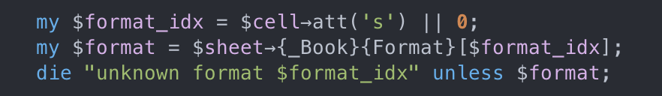
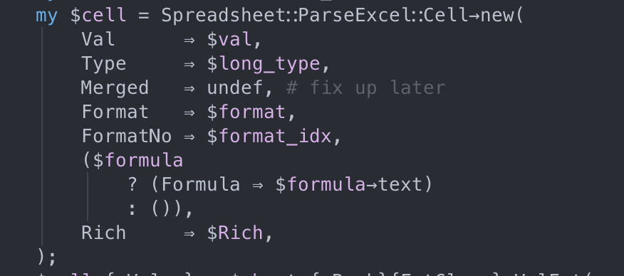
Where’s $oCell→{FormatNo}
Attribute s in <c> is the id of cell format

Slide 23
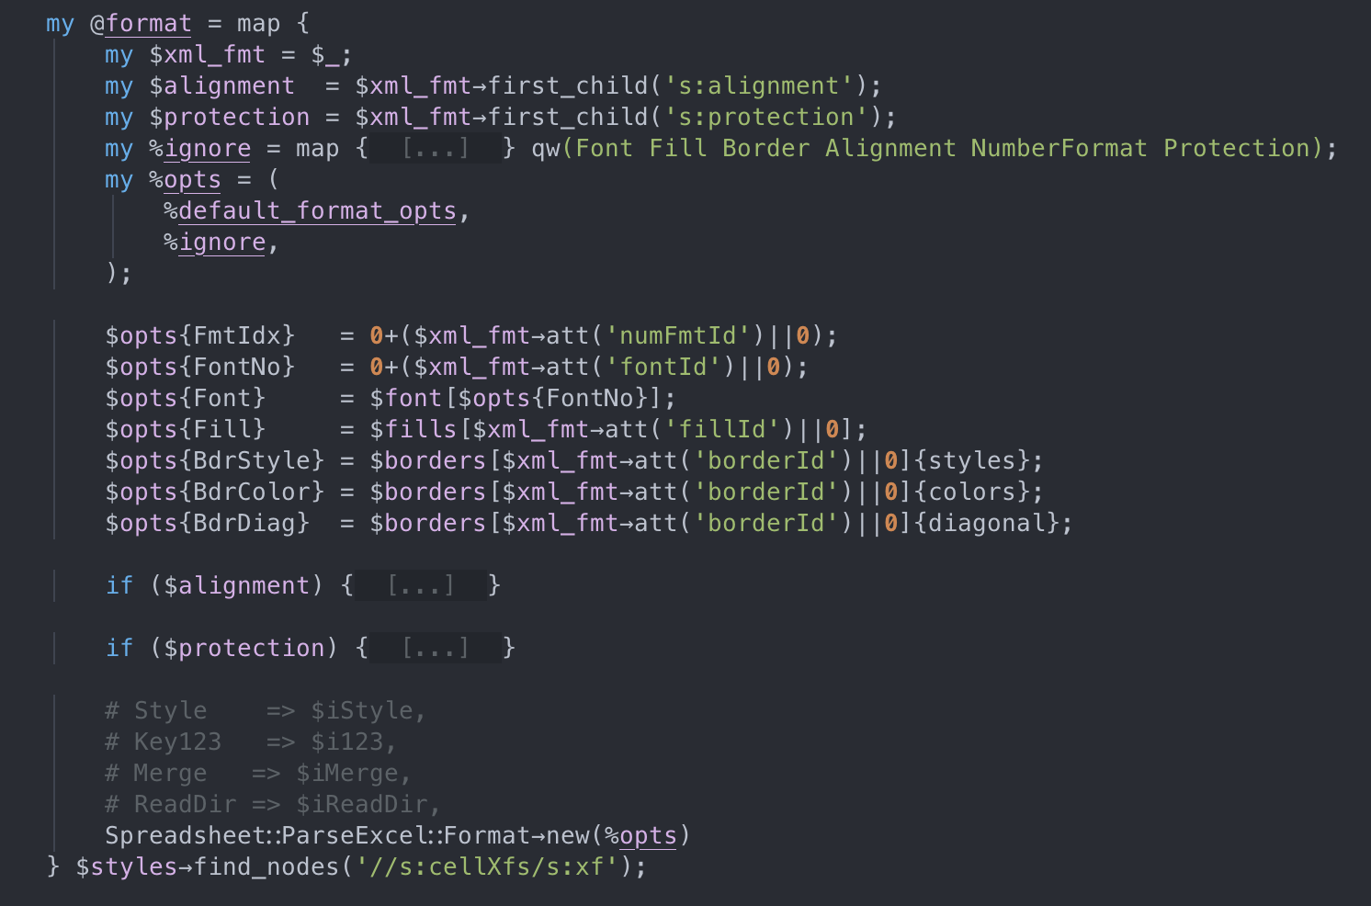
Where’s $oBook→{Format}[]→{FmtIdx}
Attribute numFmtId in <xf> is the id of the format string

Slide 24
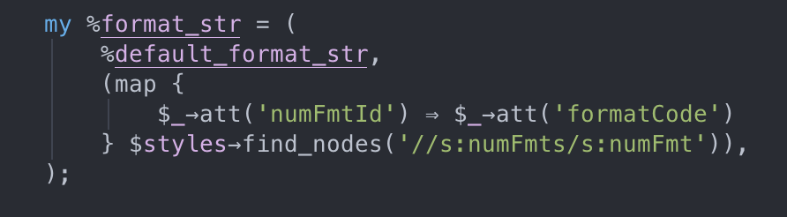
Where’s $oBook→{FormatStr}
Attribute numFmtId in <numFmt> maps to numFmt in <xf>
Attribute formatCode in <numFmt> is the actual format string

Slide 25
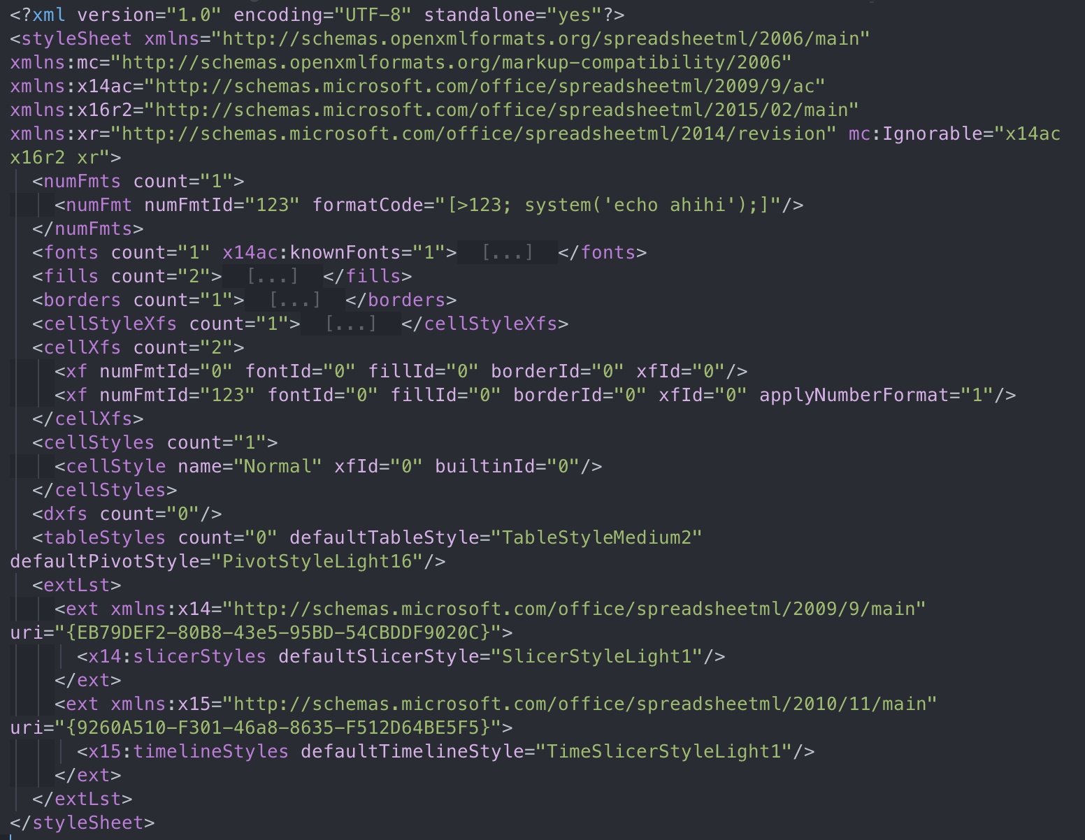
Final payload
xl/styles.xml
When put into the eval, the command will be
eval(“$number >123; system(‘echo ahihi’);”)
Cell format is in the 2nd position
=> FormatNo = 1
Notes:
Let's get to the final payload.
First, I chose 123 to be the FmtIdx, then inject the command to a new <numfmt> element in this styles.xml file
I created another <xf> element to define a new cell format, that points to the malicious format string
This <xf> element is the second one, so FormatNo would be 1

Slide 26
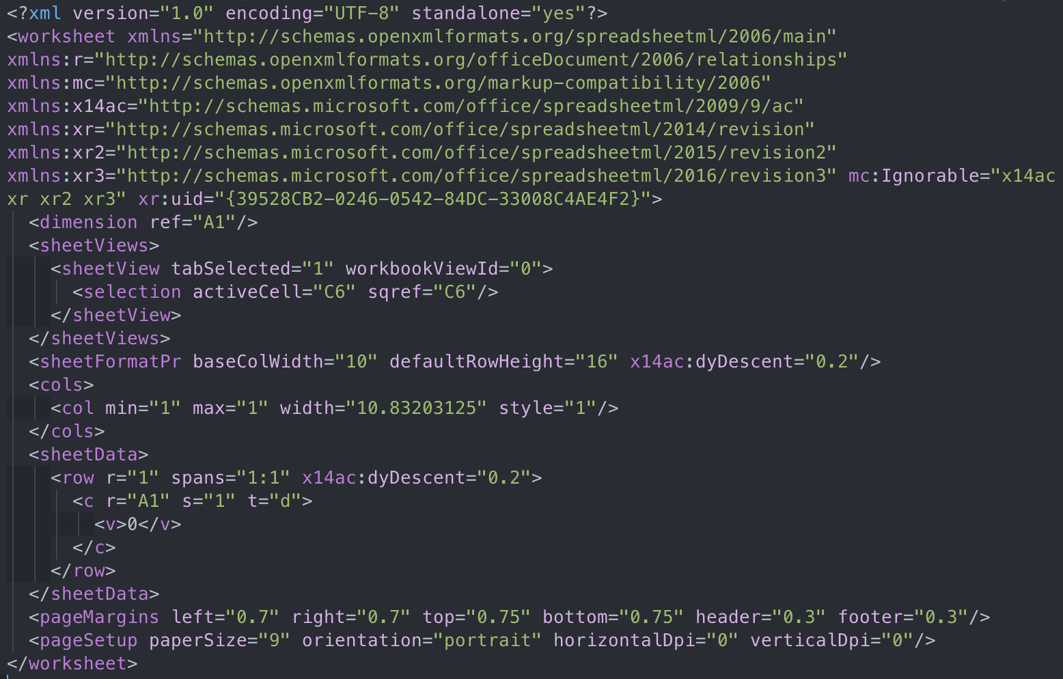
Final payload
xl/worksheets/sheet1.xml
s=“1” - FormatNo = 1
t=“d” - type Date
Notes:
Finally, I created a new cell element in sheet1.xml file.
The cell should have date type and formatNo equals 1.

Slide 27
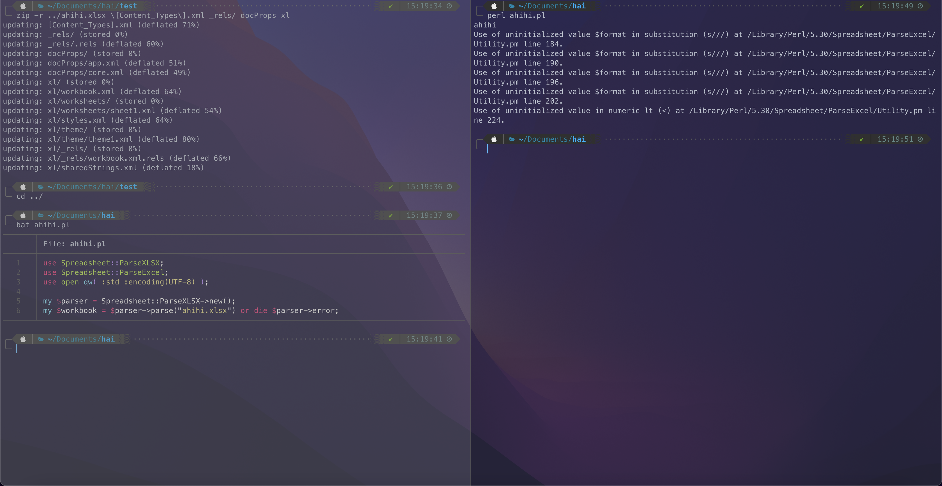
Final payload
Notes:
You can see that the command ran successfully, so the exploit worked

Slide 28
Easter egg: out-of-memory
Sheet size (min/max width/height)
Header/footer name
Sheet margins
Save some configs for printing sheet?
Handles merged cells
Settings for rows & columns
Settings for each column (hidden, styles, etc)
Current cell selection
Self explanatory
Data for each cell in each row
Notes:
I mentioned before that there are 2 interesting parts, so let's get to the second one: handling merged cells

Slide 29
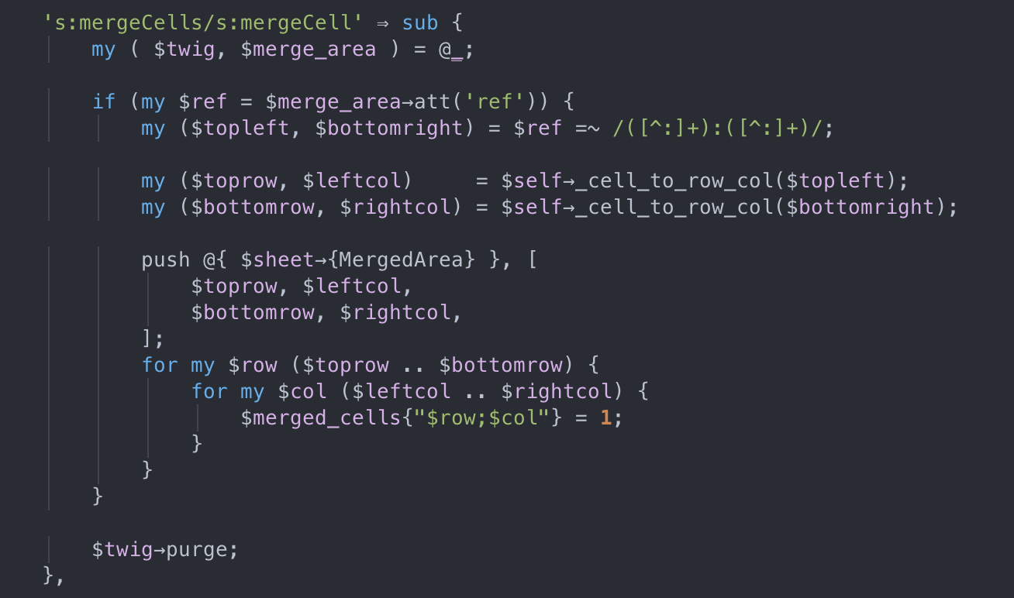
Easter egg: out-of-memory
Read the range of a merged cell
Oh...
Notes:
This part basically reads a string defining range of cells to be merged.
But it eagerly marks all of those cells as merged by creating lots of entries in a dictionary.

Slide 30
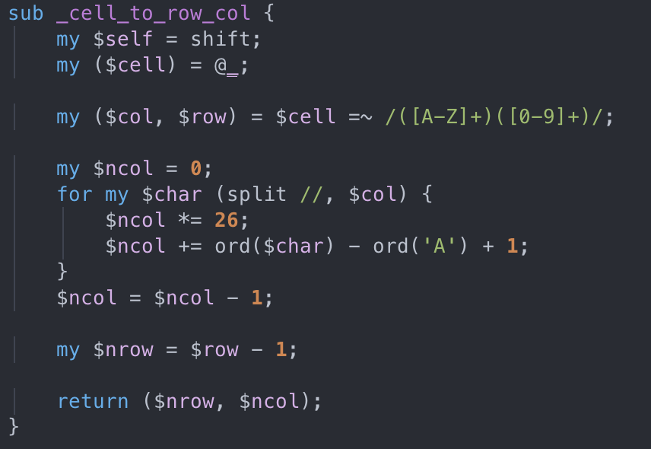
Easter egg: out-of-memory
And no limit in merged cell’s dimension
¯\_(ツ)_/¯
Notes:
And even better, there is no limit in those range.

Slide 31
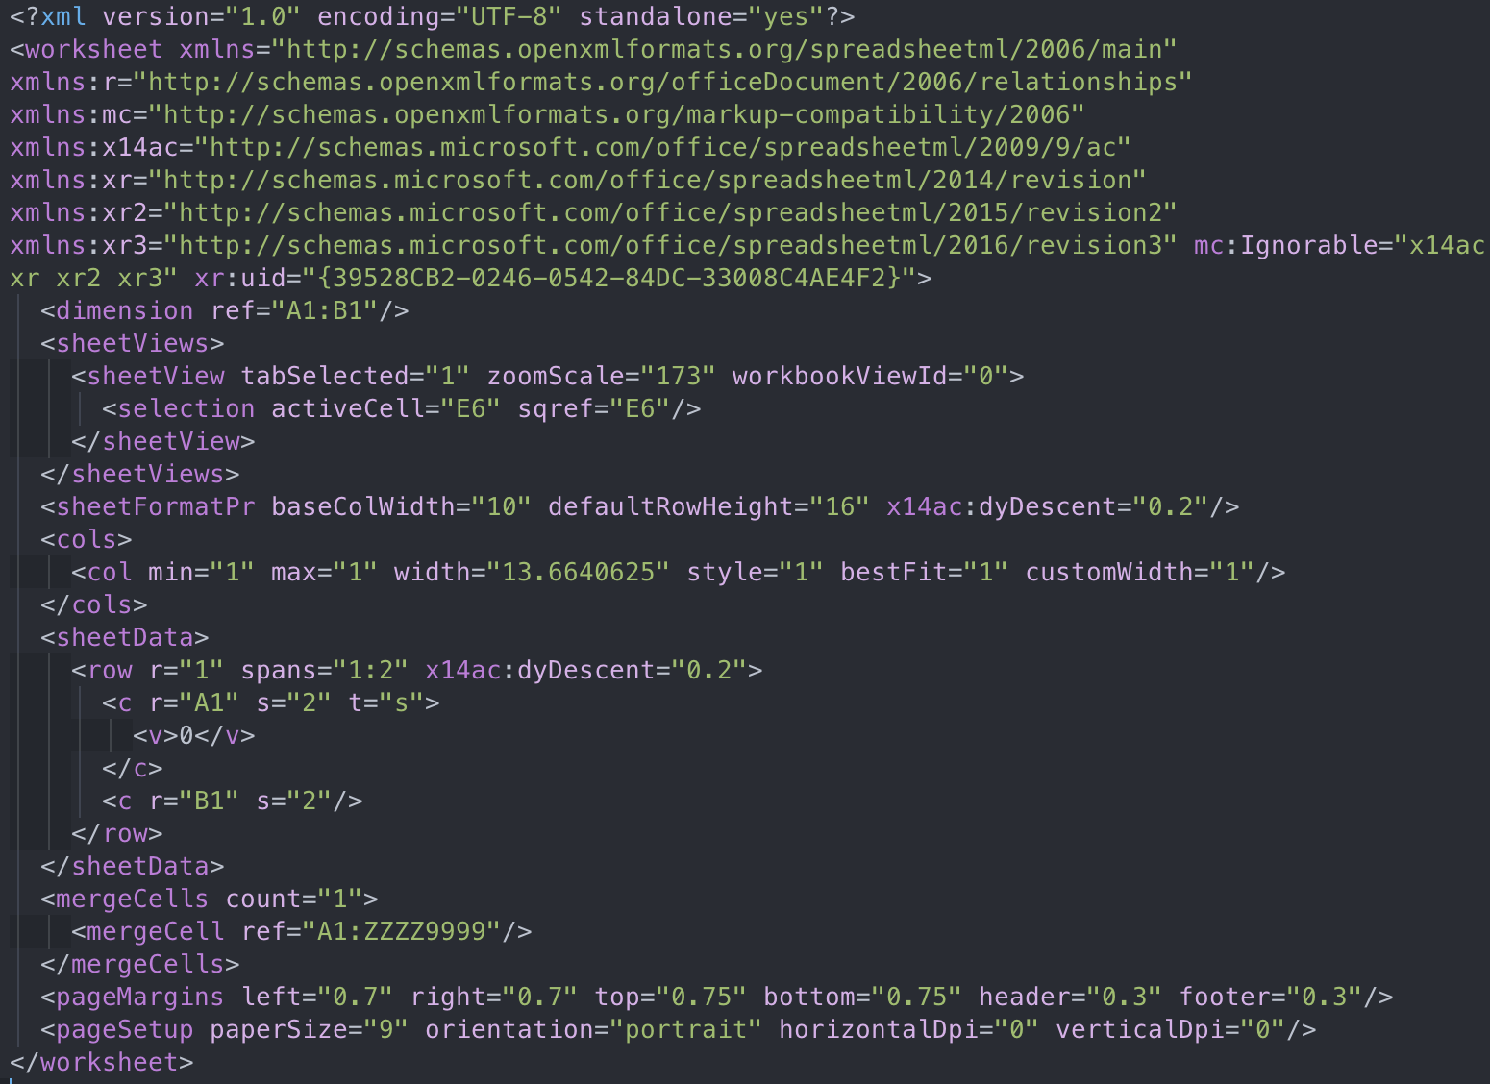
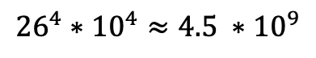
Easter egg: out-of-memory - Payload
xl/worksheets/sheet1.xml
The parsing process would allocate at least
$${26}^{4}∗{10}^{4}≈4.5 ∗{10}^{9}$$
bytes
Notes:
So if I added a mergedCell element in this sheet1.xml file, it should allocate over 4.5 GBs dictionary to parse

Slide 32
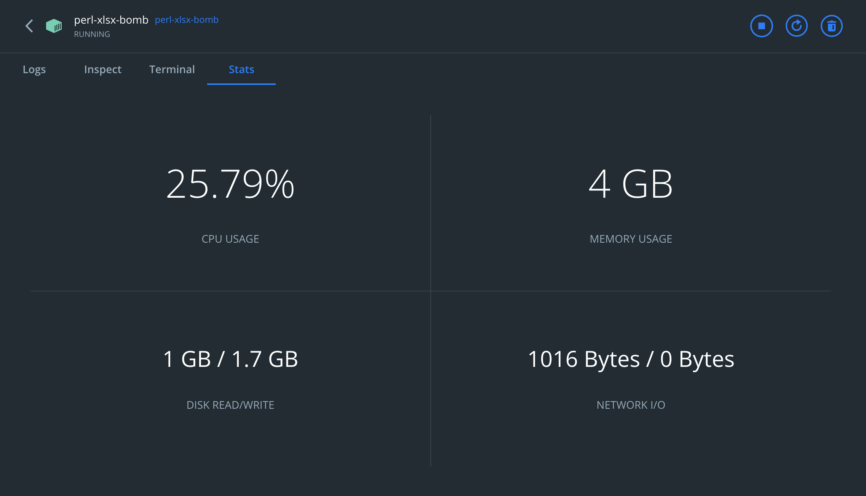
Easter egg: out-of-memory - Payload
Perl script runs on a Docker container, with 4GB RAM limit.
Memory is quickly filled and Disk IO increases for swapping.
Unfortunately, the process was killed before it finishes parsing.
Notes:
To try with the impact, I created a docker container having only 4GBs RAM.
Memory usage sky-rocketed and memory limit is quickly met.
After that, Disk utilization increases to perform swapping.
Maybe this parsing crashes the container so it was killed before finishing.

Slide 33
Mitigation - RCE
The most suitable action is to issue a patch for the library or use an alternative.
ParseXLSX is quite limited in configurability. However, fortunately, it allows adding a custom formatter class.
Notes:
And now are some mitigation methods I came up with.
For RCE exploit, it's quite trivial because as I mentioned earlier, we can create our own customized formatter, instead of theirs. This will require more work from developers, however.

Slide 34
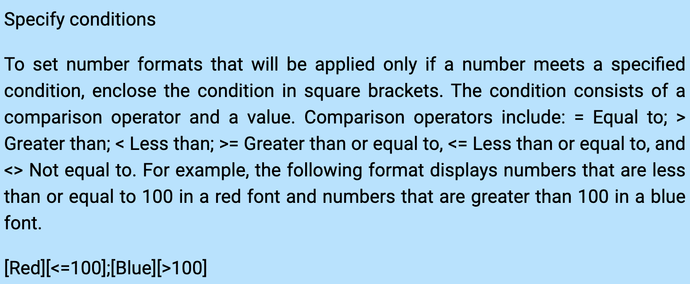
Mitigation - RCE
Since supported conditions are just numeric comparisons, we can easily write a condition checker instead of throwing into eval
Notes:
But still, it's feasible, because according to the reference, conditions are just simply numeric comparisons, so a simple switch-case can cover all of it, instead of eval.

Slide 35
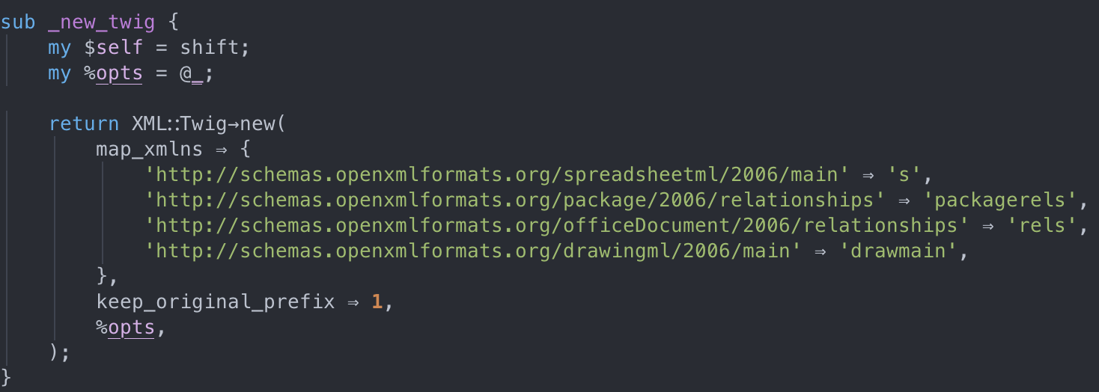
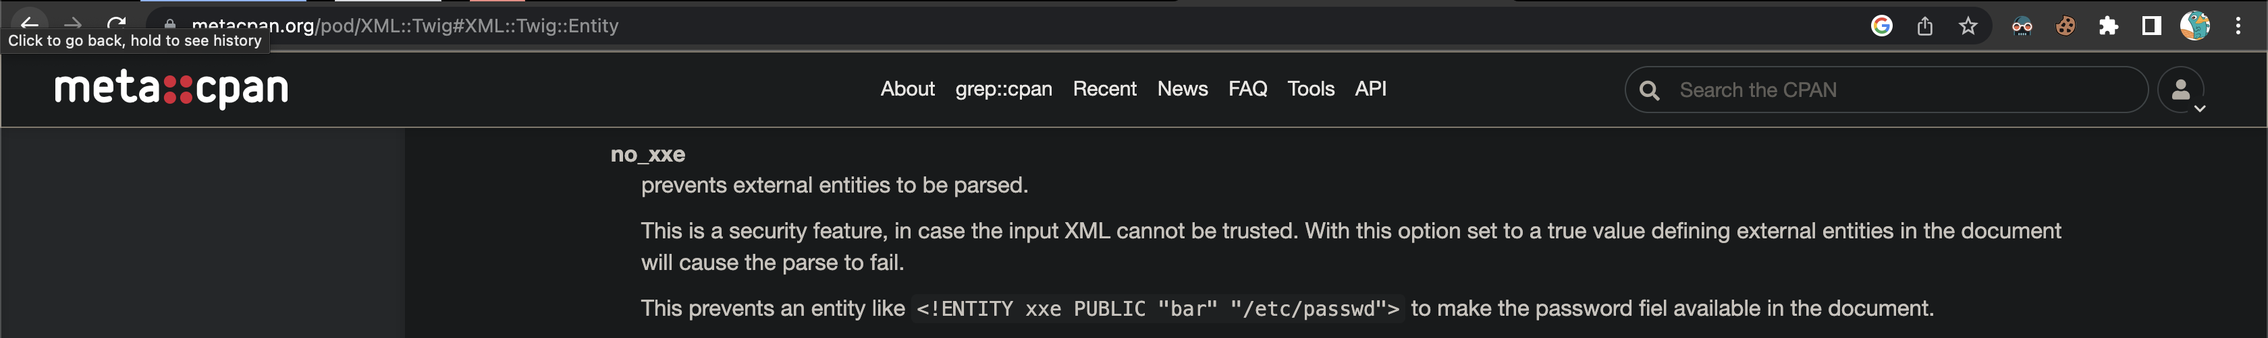
Mitigation - XXE
To read xml files, parser uses XML::Twig. It allows blocking XXE with no_xxe option, but wasn’t used by the parser.
Notes:
For XXE exploit, it should've been avoidable.
ParseXLSX uses Twig to read xml files, and they do provide a method to block XXE injection, but they didn't include in their option list.

Slide 36
Mitigation - XXE
This behavior can’t be customized, so the only way is to patch the library itself.
Notes:
So, the only way to avoid this is to patch the library locally, or requesting changes from the authors.

Slide 37
Mitigation - Out-of-memory
Same goes with XXE, the behavior can’t be customized.
Notes:
Out-of-memory attacks is the same as XXE, this cannot be customized.

Slide 38
Thank you
for listening

